Slide 1
SAP BTP Extension Suite Training
Day 11
Anubhav Oberoy
www.AnubhavTrainings.com
Follow excellence with sheer passion

Slide 2


DISCLAIMER
The training content and delivery of this presentation is confidential, and cannot be recorded, or copied and distributed to any third party, without the written consent of Anubhav Trainings

Slide 3
Agenda – Day 11
01
HDI Containers and Deployment
02
Working with HANA Database Explorer
03
HDI Containers and Deployment

Slide 4
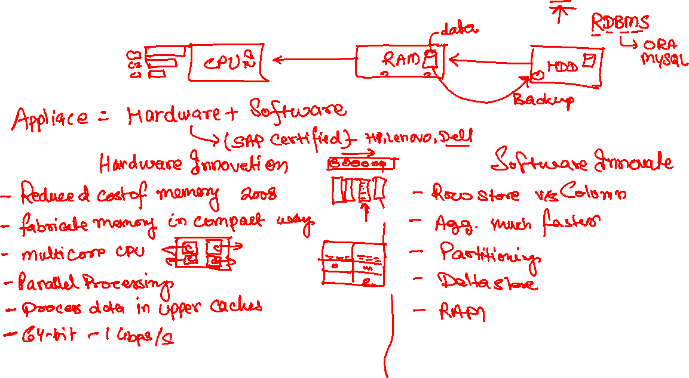
HANA- High Performance Analytic Appliance

Slide 7
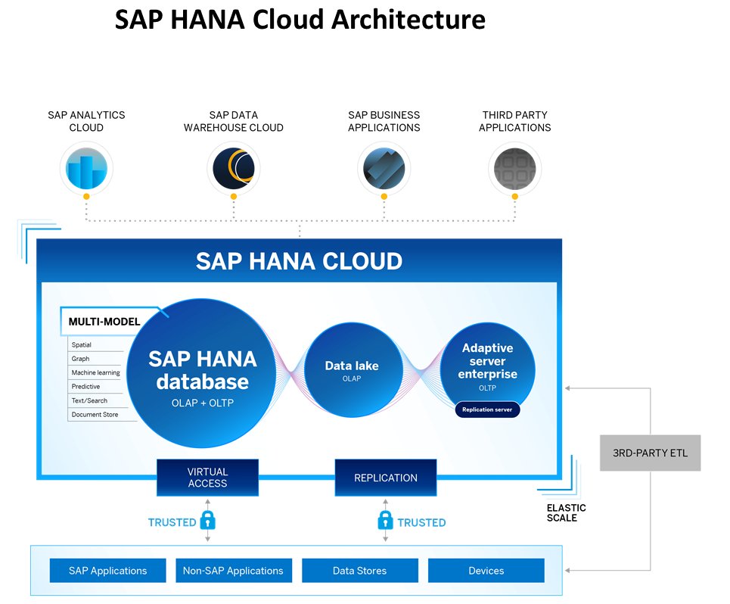
Introduction to HANA Cloud
SAP HANA Cloud is a fully managed, in-memory, cloud database as a service (DBaaS). It is the cloud-based data foundation for SAP Business Technology Platform. With SAP HANA Cloud you can create, run, and extend new and existing applications.
SAP HANA Cloud includes a number of software components. The core component is SAP HANA Database, but other components can be added at any time, such as a data lake.
Key Components of SAP HANA Cloud
There are four key components of SAP HANA Cloud:
SAP HANA Cloud, SAP HANA Database
In-memory database with built-in advanced analytics (spatial, graph, text, etc.)
SAP HANA Cloud, data lake
Store and query large data sets and most file types
SAP HANA Cloud, adaptive server enterprise
Support for extreme –performance transactional applications
SAP HANA Cloud, adaptive server enterprise replication
Bi-directional real time data replication across databases

Slide 8
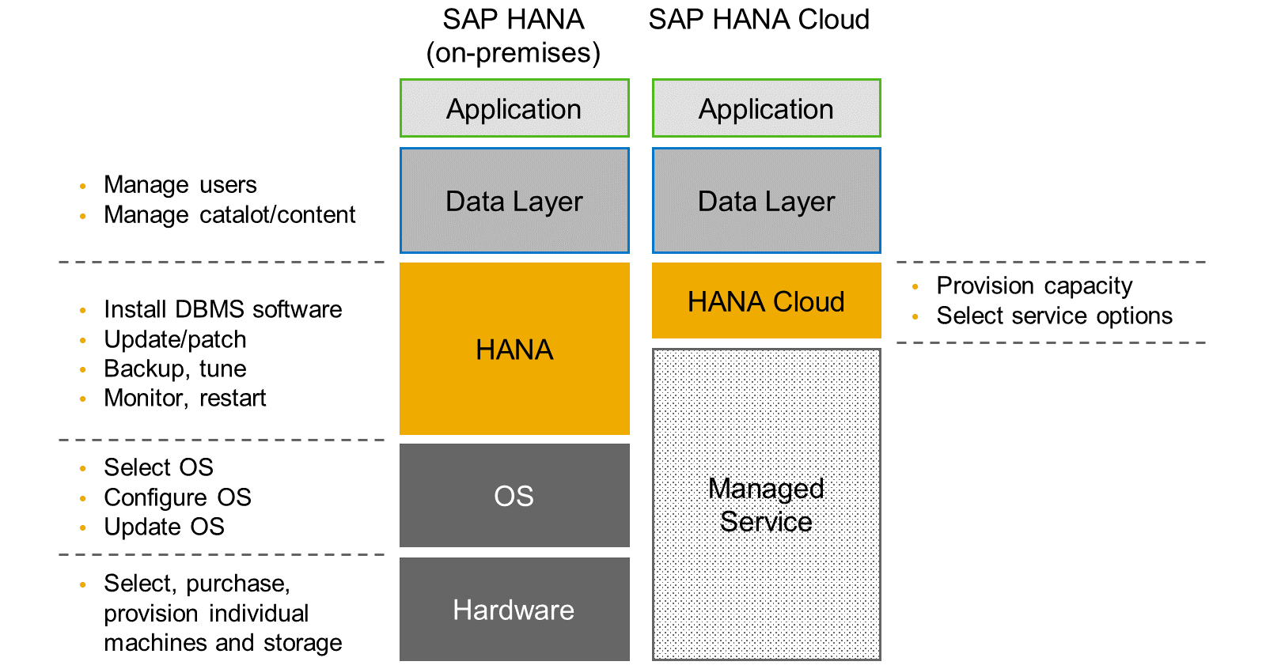
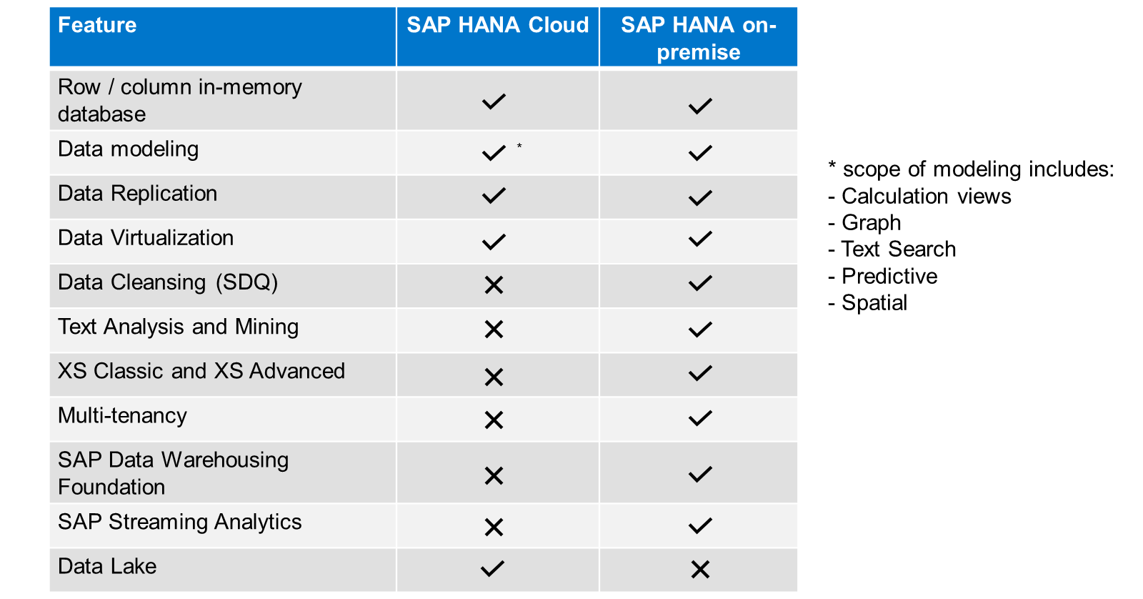
HANA Cloud v/s On-premise
Feature Differences
SAP HANA Cloud compares very closely with SAP HANA on-premise in terms of features but there are some differences.

Slide 9
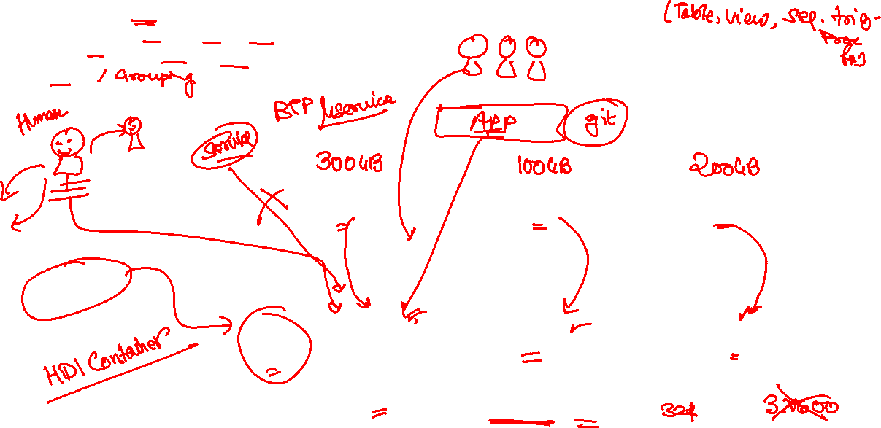
What is Schema in HANA
Schema – Is a mandatory database object of database which stores other database objects.
It’s a logical separation of database objects.
It is home of all the runtime object
Security
BW
ekko
ECC
ekko
S/4HANA
ekko
Non-SAP
SAP HANA 600GB
SCBW
ekko
ECC001
ekko
SAPS4C
ekko
MIG
ekko
SYS

Slide 10
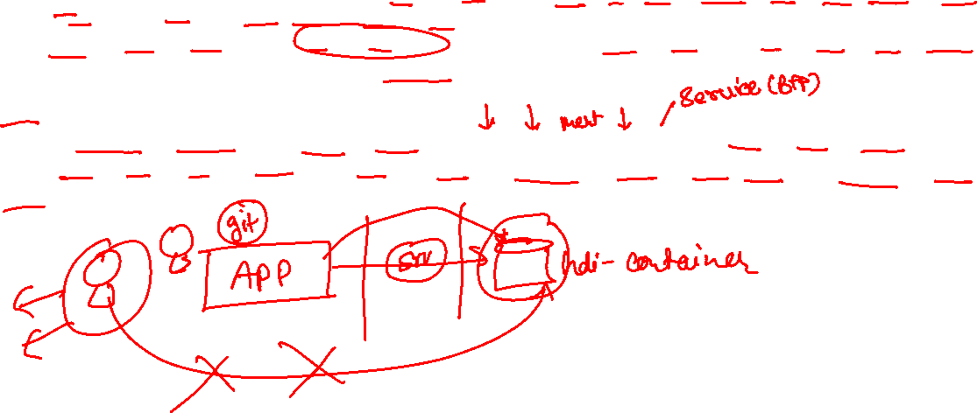
HDI Container
An HDI Container is also a schema. But it is managed differently from a normal schema.
Schema -- How its created?
Manually create it in BTP
Application Managed HDI Container (You as developer ONLY work with App, App will talk to HANA to create and manage this schema to store/read data internally)
You cant access HDI Container using HANA Studio (Deprecated tool), We can use new SAP HANA Database Explorer, SAP HANA WebIDE for OP or BAS to access HDI Container.
HDI -- Who creates it?
There is a new service in SAP HANA called SAP HDI (HANA Deployer Infrastructure) which is just a microservice responsible to managing the container. HDI Deployer is a component which is used to talk to this service from our app.

Slide 11
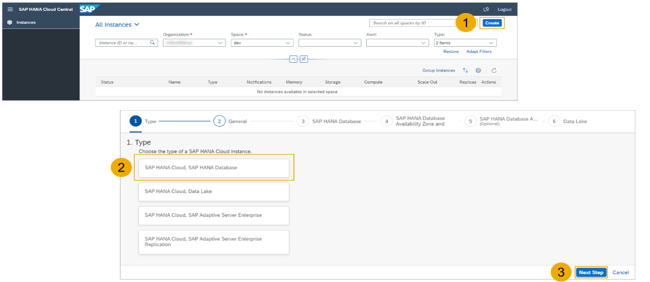
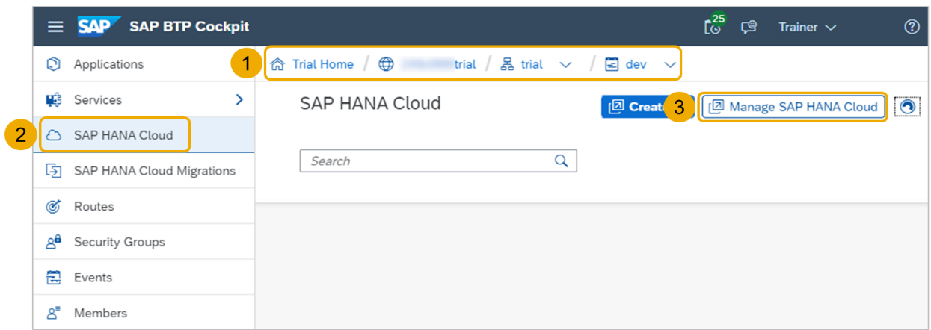
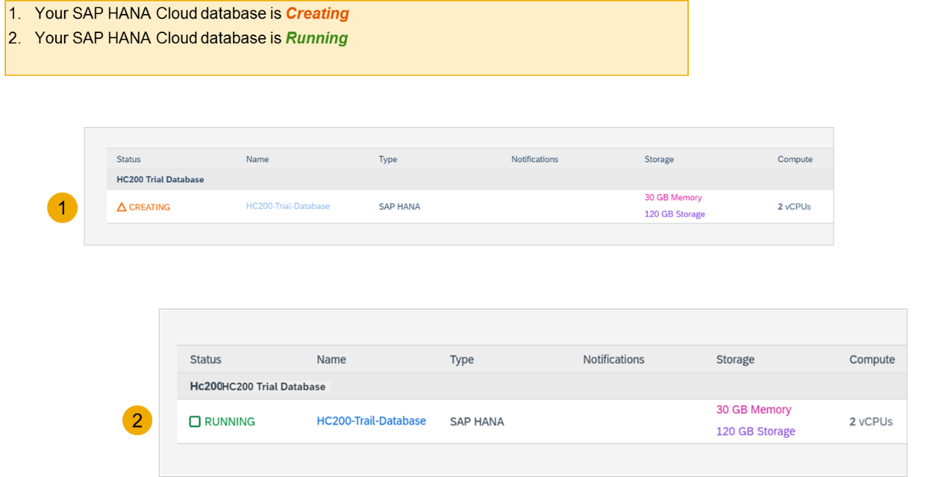
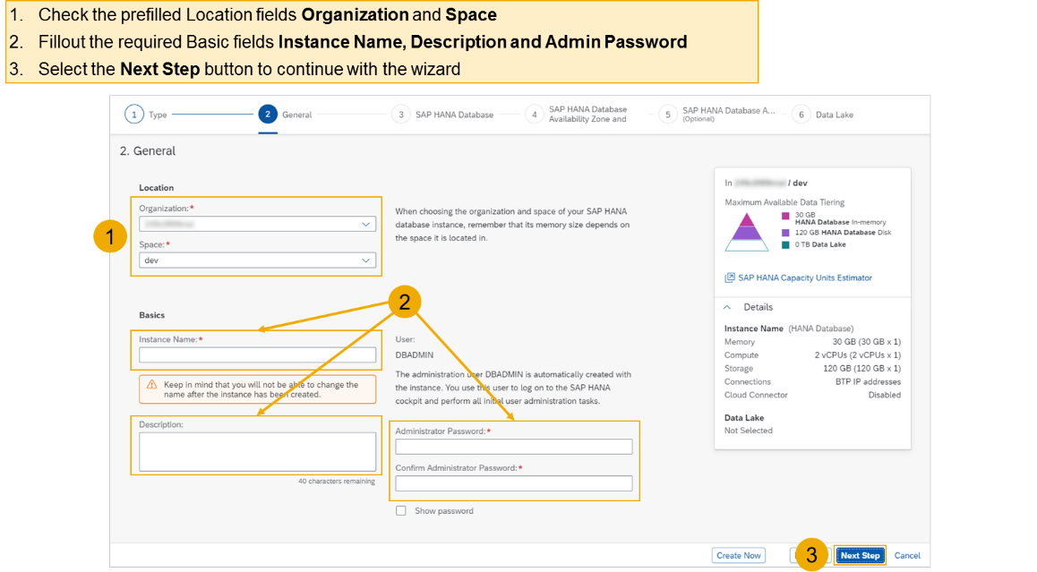
Hands on - Create HANA Cloud Instance
Login to your trial and navigate to your dev space
Select SAP HANA Cloud
Select the Manage SAP HANA Cloud button to start the SAP HANA Cloud Central
Select the Create button to start the wizard
Select the SAP HANA Cloud instance Type to create
Select the Next Step button to continue

Slide 12
HDI Container
An HDI Container is also a schema. But it is managed differently from a normal schema.
Schema -- How its created?
Manually create it in BTP
Application Managed HDI Container (You as developer ONLY work with App, App will talk to HANA to create and manage this schema to store/read data internally)
You cant access HDI Container using HANA Studio (Deprecated tool), We can use new SAP HANA Database Explorer, SAP HANA WebIDE for OP or BAS to access HDI Container.
HDI -- Who creates it?
There is a new service in SAP HANA called SAP HDI (HANA Deployer Infrastructure) which is just a microservice responsible to managing the container. HDI Deployer is a component which is used to talk to this service from our app.

Slide 13
Hands on - Create HANA Cloud Instance
Login to your trial and navigate to your dev space
Select SAP HANA Cloud
Select the Manage SAP HANA Cloud button to start the SAP HANA Cloud Central
Select the Create button to start the wizard
Select the SAP HANA Cloud instance Type to create
Select the Next Step button to continue

Slide 14


































Slide 15












CAPM

Slide 16
Hands on – HANA Cloud Integration
Pre-requisites
Check the version of CDS (which must be > 2.0) cds –v
Start a HANA cloud instance in SAP BTP
Main steps
Add hana configuration to our app, which tell cap framework that the default db is now hana – cds add hana
2. Add the hana specific deployment format name to our project under cds section as below inside package.json file "hana":{
"deploy-format":"hdbtable"
}
3. Since the first step added the hdb node module, we need to install it. Run npm install
4. We need to perform a build, which will create all the hana specific files which will be deployed to HANA cloud. cds build --production
5. We need to login to cloud foundry from BAS – cf login
6. Finally we need to deploy the DB and everything to SAP HANA Cloud – cds deploy --to hana:batman
7. We fixed issues related to excel format of HANA and changed the size of field bankid for employee, redo the build and deploy
8. If deployment worked, a new file cdsrc-private.json gets created automatically, this file contain the information about which container in SAP BTP HANA Cloud to connect to. And the private key is stored in this file.
9. Provide the credentials which will be used to connect database, start using cds watch --profile hybrid
"credentials": {
"database": "batman-key"
}

Slide 17
Authentication v/s Authorization
Authentication – It ensures that is our user a valid user? Has he/she entered valid credentials to login to our app. It is enforced by a login screen. This login screen can also come from IDP like SSO, LDAP, Social integration.
Authorization – Once user is authentication, then the authorization comes into play. It ensures, is our user allowed to do certain activities inside app. What is the level of access. E.g. create, update, delete, approve, view.
SAP BTP cf environment has a special component called XSUAA –
XS – eXtended Services
UAA – User Account and Authorization
This is an in-built component inside of CF
It is responsible to control the user account and authorization
It manages our application security
In CF we use modular approach to address security
As a developer we need to decide what roles and level of security we need in our app. Example, we need to secure odata resource /Anubhav.svc
Usually we define Viewer, Editor
We need to define our scope and role templates inside a special file called xs-security.json file
XSUAA Communicates to the IDP – Identity Provider
Issues JWT (JSON web Token) to cloud foundry router which let user access the app based on permission.
Scope
(Role)
* *
Role Template
* *
Role Collection

Slide 18

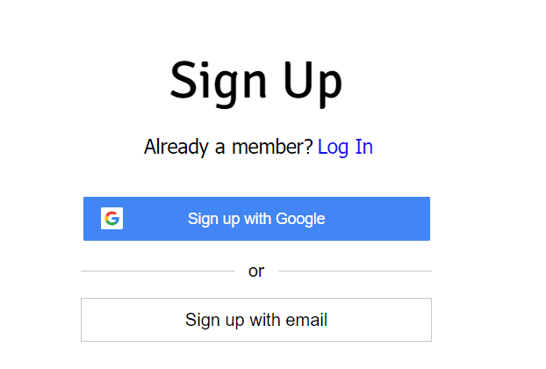

IDP – Identity Provider
An identity provider is a software or group of software which stores all the user credentials and their scopes (roles) in itself. This will centralize the user management in company and simplify the login process to different apps. This way user do not need to remember multiple passwords to multiple apps.
Portal
Launchpad
Dedicated SRM
SSO
SAP Server
GSuite
LDAP
User/email/password
Single source of truth
Trust relation
Scope- clerk, manager, ceo
Outlook
Our cloud app
xsuaa
XSUAA

Slide 19
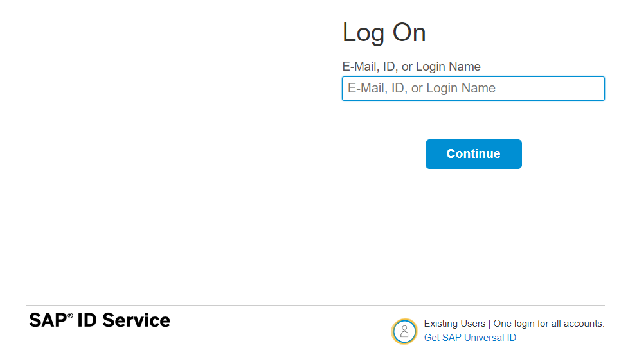
How it works behind scenes
xs-security.json contains information which we need to register to define what are all permissions required in our app
code
JWT
App
Browser
postman
ourxsuaa
trust
JWT
XSUAA
Scope
SAML
trust
IdP

Slide 20

Hands-on Add Security and Test Microservice
cds add xsuaa

Slide 21

What We Did
Let’s Summarize

Slide 22

www.anubhavtrainings.com
Thank You
End of Day 6

Slide 23


We’re committed to empower you to be
#FutureReady
through powerful training solutions.
We build the workforce of the future.
260+
Corporate Clients
60,000+
Learners Trained
26000+
Learners Placed
FREE WEBINARS
Sign up for free webinars with industry experts every fortnight!
Enroll Now!
Contact us today!
https://anubhavtrainings.com

